Slide 1
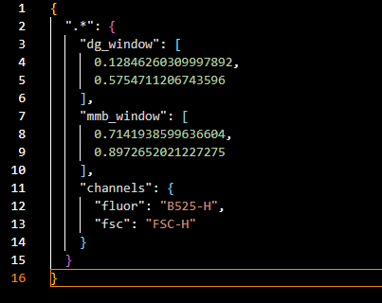
The main questions raised during our November meeting:
Can the code distinguish between the different MMB sizes?
Some events start at a lower MMB size but then smear into larger sizes, can the code correctly count it as part of the lower size band?
Do we need to run the MMB and DG controls in plasma for appropriate global gating or will suspension in water suffice? – yet to be decided (Flow Jo images for comparison?)
Output from previous ‘Advanced FCS Visualiser’ (using controls):
.JSON file with global MMB size window (FSC-H) + global fluorescence DG window (B525-H)
In Jan 2026, updated logic → use window for DG too, not a cut-off

Slide 2
Output from the MMB Boundaries extractor module:
FSC-H dependent differences to create MMB 3, 6, and 8 boundaries, again saved into a .JSON file
Steps (show graphs on logbook):
Applies logicle transformation to only MMB files
To each file, applies Gaussian KDE to obtain smooth distributions of density vs FSC-H
For each file, the dominant peak (highest density) is selected and then the FSC-H value at 5% of the maximum density to the left is calculated and stored as the ‘start_FSC’
Then, for each class size (3 vs 6 vs 8), the median of the start_FSC is calculated separately
This forms the boundaries as follows and integrates with the global MMB window
MMB 3 = [lower bound of global window, median start_FSC of MMB 6]
MMB 6 = [median start_FSC of MMB 6, median start_FSC of MMB 8]
MMB 8 = [median start_FSC of MMB 8, upper bound of global window]
Using median FSC solves the ‘smearing issue’ since it is less prone to be affected by outliers compared to mean FSC
The .Json file for MMB threshold extractor is extremely detailed (show)

Slide 3







FSC-H
The ‘Beta’ version of the GMM Clustering module, overall logic:
Restricting analysis only to events within the overlap of the two windows – Region of Interest (ROI)
Within the ROI, use the GMM to probabilistically separate the events using fluorescence only since MMB sizes are well-defined (also simplifies workflow)
For simplicity, we introduced only 3 fluorescence states (tri-state GMM) using patient data within the ROI:
Low fluorescence (no DG) = 25th percentile,
Medium fluorescence (sandwich) = 50th percentile,
High fluorescence (multi-binding aggregates) = 75th percentile
ROI
q25
q50
q75
B525-H
GMM’s posterior probability – What is it?
3 possible fluorescence states,
One event could be in between two states, so we use the expected value instead of forcing
So instead of 5 sandwich events, we could have 5.75 sandwich events

Slide 4
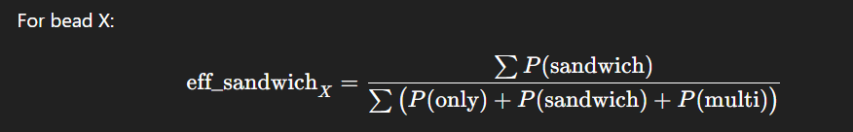
Using the rationale and the previous gating strategy, the following 9 clusters sound more realistic:
MMB 3 only, sandwich, multi-binding/aggregate
MMB 6 only, sandwich, multi-binding/aggregate
MMB 8 only, sandwich, multi-binding/aggregate
If we apply the DG window, realistically, we lose DG-only events and filter out noise
Output from the GMM clustering module:
.JSON files for each patients with detailed information on hard counts, expected counts (posterior weighted), MMB + DG boundaries used, percentiles used, etc. (show)
Excel sheet with filtered values, especially with metrics such as sandwich efficiency factor and multi-binding efficiency factor, X = 3, 6, 8 (show)
2D plots with clearly defined boundaries and a clear difference pre-GMM (individual + multi-pane)

Slide 5
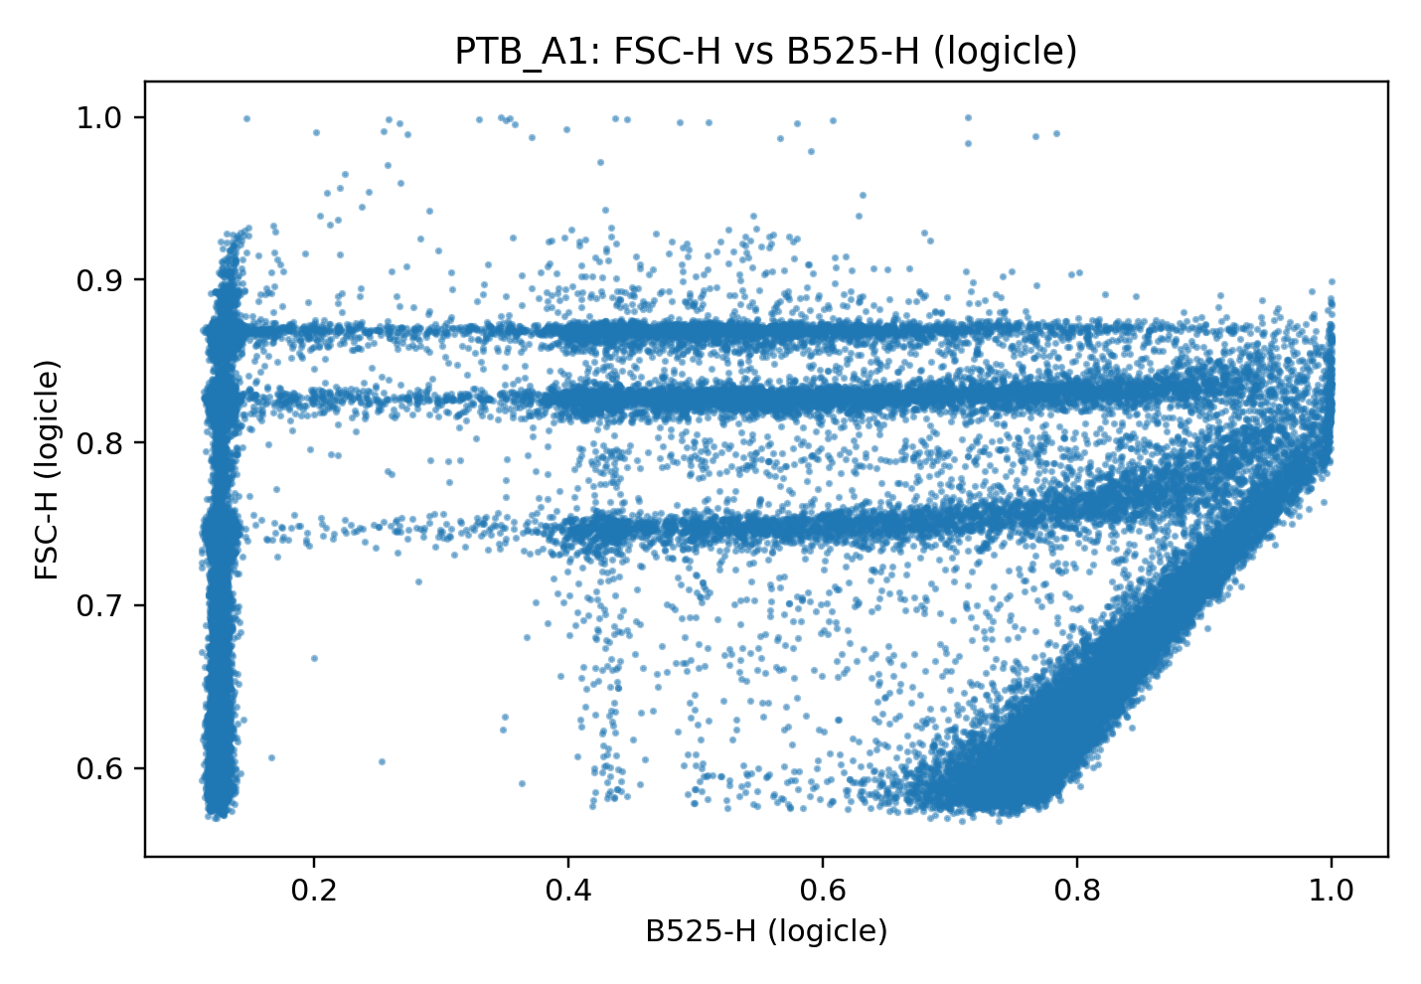
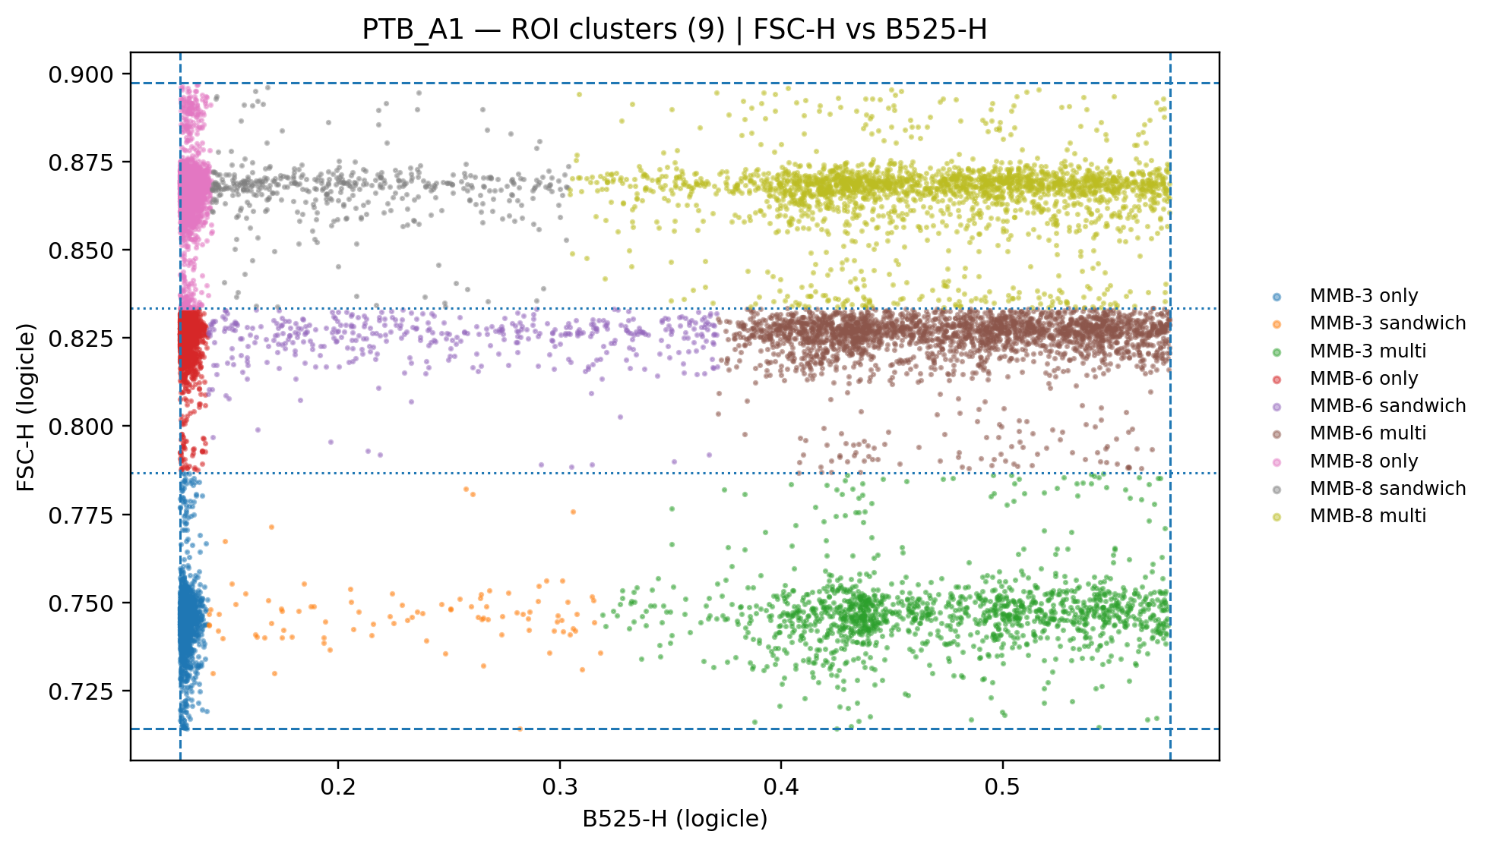


Slide 6
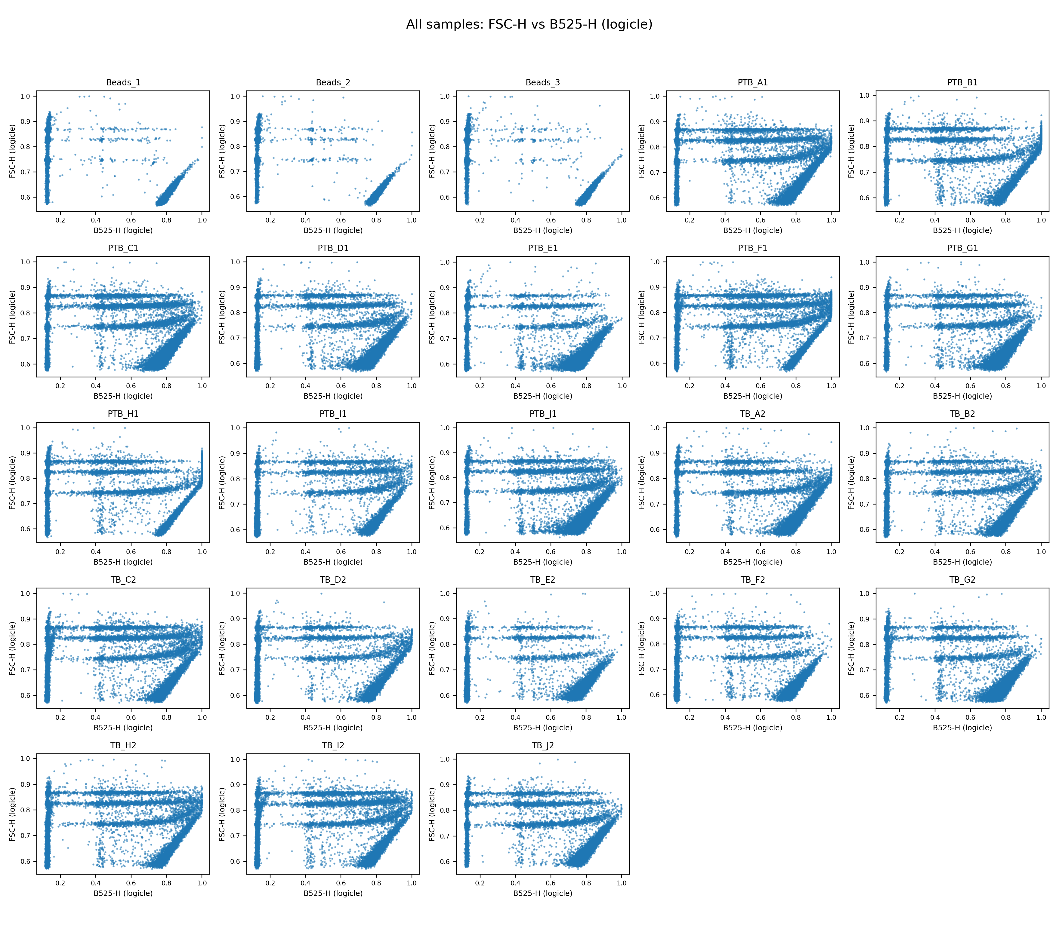

Slide 7
